Slide 1
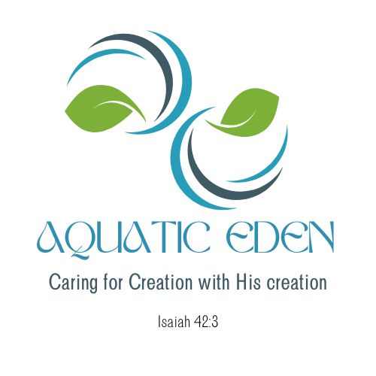
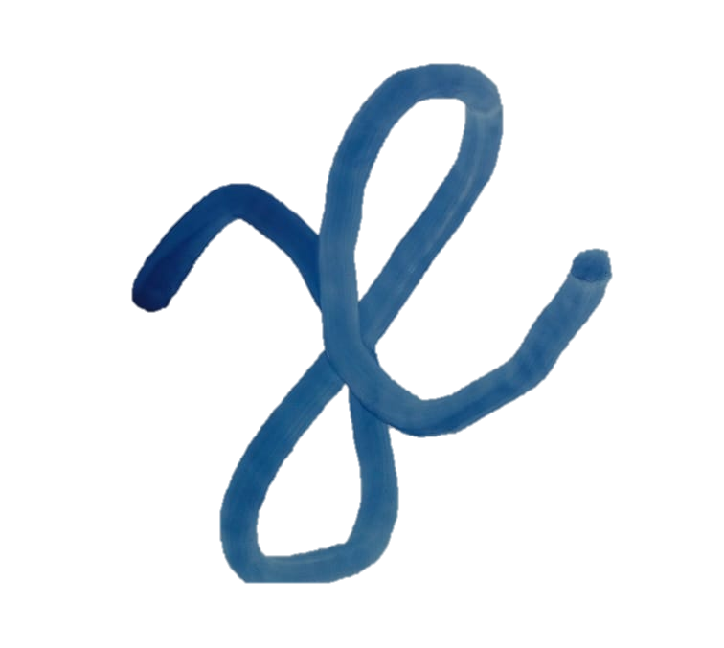
The story behind our logo…
1
2
3
4
5
1
This was how the current logo looks like when we first conceptualize it. We designed it around the two-roman character of “a” and “e”.
The design team also wanted something simple and elegant, soothing on the eyes of the recipient.
Seeking inspiration from our work, we were inspired to use the element of water and the aquatic plant, Anubias Barteri to form the logo of “ae”.

Slide 2

The story behind our logo…
1
2
3
4
5
Water – these swirls represents water, the movement of water. As water swirls, it reflects light.
Regardless of the season of life, water is always present around us.
Water not only nourishes, but it also calms us and soothes the pain in our lives.
More importantly, water brings and gives life.
Here in Aquatic EDEN, we hope to journey with our friends, guiding them towards the Water which heals, cleanses and gives life.
2

Slide 3


The story behind our logo…
1
2
3
4
5
3
Inspired by the Anubias plant, an easy to care for aquatic plant which originates from Africa, it is hardy, resilient and highly adaptive. When lavish with love and care, it may even flower with either a purple or white flower above the water line.
Within the family of the anubias species, there are different cultivar available across different sizes with different shades of green adorning the humble yet elegant anubias bateri family.
Here in Aquatic EDEN, we seek to be resilient and adaptable in our service to our friends, journeying alongside them with elegance and humility.

Slide 4

The story behind our logo…
1
2
3
4
5
4
The name of the company, Aquatic EDEN was presented using the font Kenao Sans Serif in Azure. It was chosen because of its semi cursive style, giving one the feel of waves in motion.

Slide 5
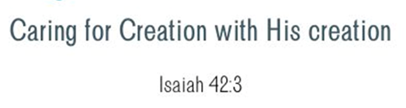
The story behind our logo…
1
2
3
4
5
5
Inspired by Scripture from Isaiah 42, Aquatic EDEN aims to seek out and care for people amongst us who have been misplaced or misunderstood for various reasons.
Be it youths, young adults, the elderly or migrants, we hope to engage them using the planted aquarium and all its formats for the purpose of friendship and wellness.
In line with our ethos of caring for those in need, we desire to be able to raise and train suitable people to be scape technicians and possibly employ them to work with us, to spread the love of God tangibly and holistically locally and in the region.

